Slide 1

Calculus 1 Introduction
What is this Calculus 1?
Why bother?

Slide 2
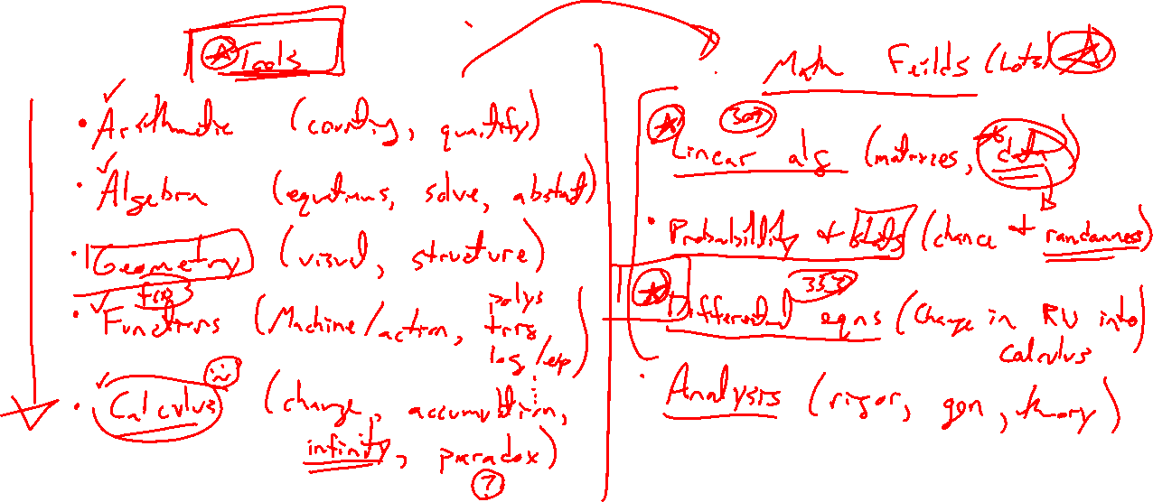
The Story of Math
Notes:
Tools: Arith (count, quantify), algebra (equation, generalize, solve), geom (visualize, strucutre),
functions (machines which capture process, poly, log, trig, graphs), calculus (change, accumulation, infinity, paradox)
Math fields: Prob and stats (change and randomness), linear alg (data), DEs (world to calculus), Analysis (rigor, gen, theory), Much more

Slide 3
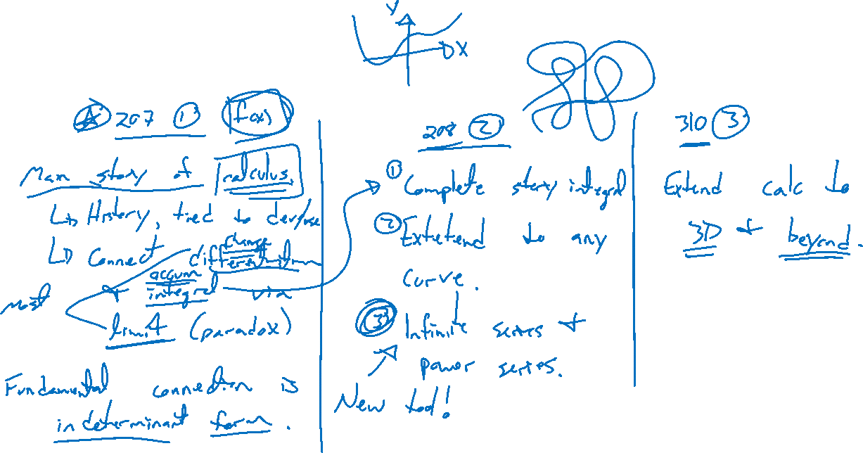
All the Calculuses
Notes:
Calc 1: Main story of calculus, derivative connect to integral, limit is foundation, fundamental question of indeterminnant form
Calc 2: Full story of integration, generalize beyond functions, infinite series / power series big new idea
Calc 3: Extension to 3+ dimensional space, closer to the real world (eng, physics)

Slide 4
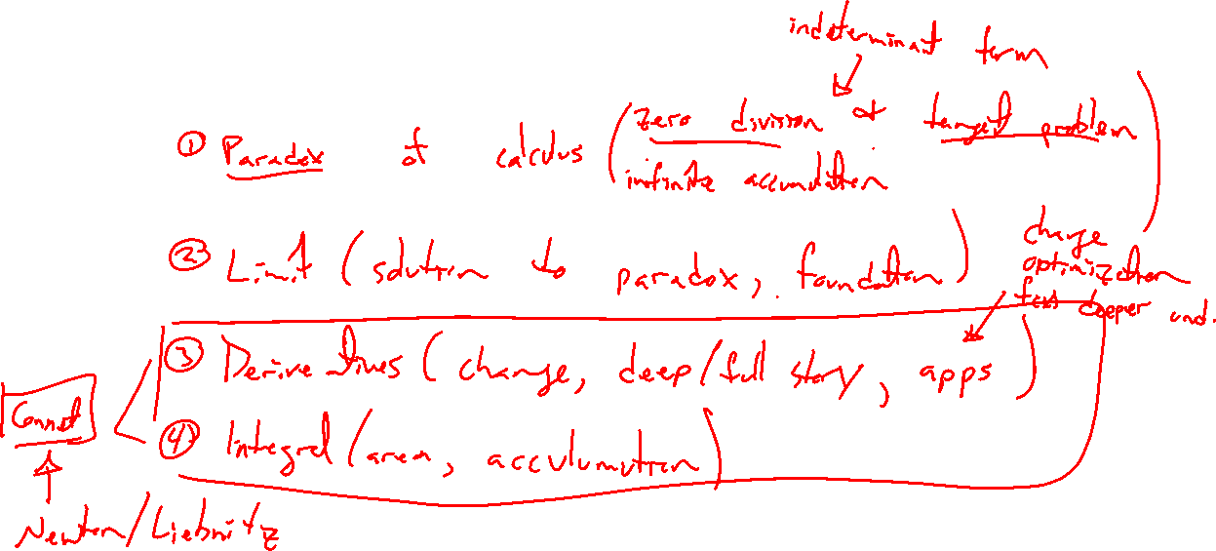
Calculus 1 Contents
Notes:
Paradox of calculus (zero div and tangent problem, infinite accumulation and integral, all indet form)
Limit (solution to paradox, foundation)
Derivative (IROC, tangent problem, full math story)
Deriv apps (change, optimization, deeper understanding of functions)
Integration (area and summation, opposite of deriv, FTOC)
Integral apps (accumulation / summation)

Slide 5
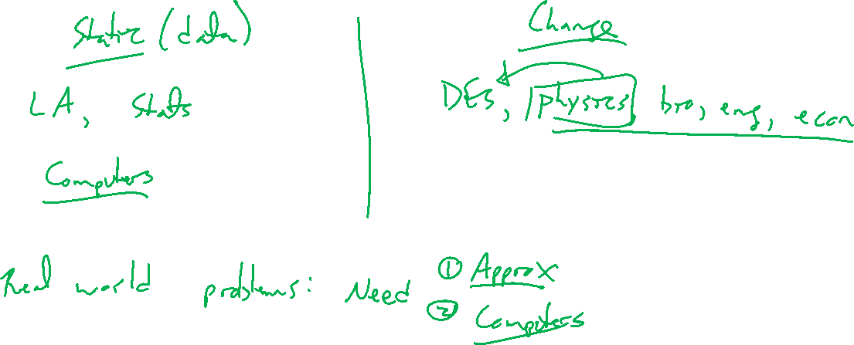
Life After Calculus
Notes:
Static (linear algebra, stats, data)
vs
Change (differential equations, laws of physics, bio, econ)
- math majors deep dive into theory to dev intuition
- real world applications involve approximation and computers

